Slide 1
Computer Networks and Internets
《计算机网络与因特网》课件
林坤辉

Slide 2
PART V Packet Transmission
Chapter 27 Network Characteristics:
Ownership, Service Paradigm, and Performance
网络所有权、服务模式和性能

Slide 3

27.2 Network Ownership
网络所有权
Network hardware and software can be owned by a single company or individual ,or it can be owned by a communication company.

Slide 4
27.2.1 Private Networks 私有网络
A network is said to be private if use of the network is restricted to the corporate or individual owner.
27.2.2 Public Networks 公有网络
A public network is owned and operated by a service provider.
Any subscriber can use a public network to communication with other subscriber.

Slide 5
27.3 Privacy and Public Networks私有与公有网络
When applied to a network, the term public refers to availability of the service, not the data transferred.
Most public networks provide private communication.

Slide 6
27.4 Advantages and Disadvantages
The chief advantage of a private network is that the owner has complete control over both the technical decision and policies.
An owner can guarantee that the network is isolated from computers outside the organization.

Slide 7
A large private network can be expensive to install and maintain
The chief advantage of a public network are flexibility and the ability to use state-of-the–art network without maintaining technical expertise.

Slide 8
27.5 Virtual Private Networks
虚拟私有网络
Known as a Virtual Private Network (VPN),the technology allows a company with multiple sites to have a private network,but use a public network as a carrier.
VPN technology restricts traffic so that packets can travel only between the company’s sites.
To build a VPN, a company buys a special hardware and software system for each of its sites.

Slide 9
27.6 Guaranteeing Absolute Privacy
VPN system use encryption(加密) to guarantee absolute privacy.
Even if an outsider does manage to obtain a copy of a packet, the outsider will be unable to interpret the contents.

Slide 10
27.7 Service Paradigm
服务模式
Connection-oriented service(面向连接的服务), connection-oriented service is analogous to telephone communication.
Connectionless service(无连接服务), connectionless service is analogous to the postal mail system.

Slide 11
27.8 Connection-oriented Service Paradigm
15.8.1 Continuous and Bursty Traffic.
15.8.2 Simplex and Duplex Connections.
15.8.3 Connection Duration and Persistence 连接期限与保持.
15.8.4 Service Guarantees
15.8.5 Stream or Message Interface

Slide 12
27.11 A Comparison of Service Paradigms
advantages.
disadvantage.

Slide 13
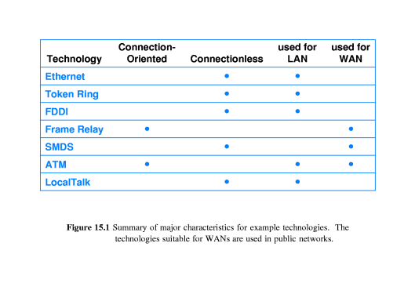
27.12 Examples of Service Paradigms 服务模式实例

Slide 14
27.13 Addresses and Connection Identifiers
地址与连接标识
In a connectionless network, each packet must contain the address of the remote destination.
In a connection-oriented network, the destination address is only used when creating a new connection, packets flowing over the connection contain a connection identifier that is smaller than a full address.

Slide 15
27.14 Network Performance Characteristics 网络性能特性
Delay 延迟.
Throughput 吞吐量.
Jitter 抖动.

Slide 16
27.14.1 Delay延迟
The delay of a network specifies how long it takes for a single bit of data to travel across the network from one computer to another.
delay is measured in seconds or fractions of seconds.
Engineers usually report both the maximum and average delay.

Slide 17
The delay is divided into several parts:
Propagation delay(传播延迟)
switching delay(交换延迟)
access delay(访问延迟)
queueing delay(排队延迟)

Slide 18
27.14.2 Throughput 吞吐量
Throughput is a measure of the rate at which data can be sent through the network.
Throughput is usually specified in bits per second(bps).
The throughput capability of the underlying hardware is called bandwidth.
Effective throughput < hardware bandwidth
Hardware bandwidth is often used as an approximation of the network’s throughput.

Slide 19
Throughput is a measure of the network capacity,not speed.
The throughput specifies how many bits can enter the network per unit time.
Imagine a network to be a road between two places and packets traveling across the network to be analogous to cars traveling down the road.

Slide 20
27.14.3 The Relationship Between Delay and Throughput
Throughput and delay are not completely independent.
As traffic in a computer network increases, delays increase.
Excessive traffic in a network is called congestion(拥塞)
A network that operates at close to 100% of its throughput capacity experiences severe delay.

Slide 21
D=D₀/(1-U);
D: the effective delay;
D₀ : the delay when network is idle;
U(0<U<1): the current utilization.

Slide 22
27.14.4 Delay-Throughput Product 延迟-吞吐量的乘积
The product of delay and throughput measures the volume of data that can be present on the network.
A network with throughput T and delay D has a total of T X D bits in transit at any time

Slide 23
27.15 Jitter 抖动
The network’s jitter represents the variance in delay.
Jitter is becoming important as networks are used for transmission of real-time voice and video.

Slide 24
作业
1.实现VPN的意义何在
2.网络时间延迟和网络吐量的关系如何
3.简述抖动对音频和视频的网上播放的影响

